Slide 1
GameCo Video Game Sales Trends by Region

Slide 2
Our current understanding: Sales for the various geographic regions have stayed the same over time.

Slide 3
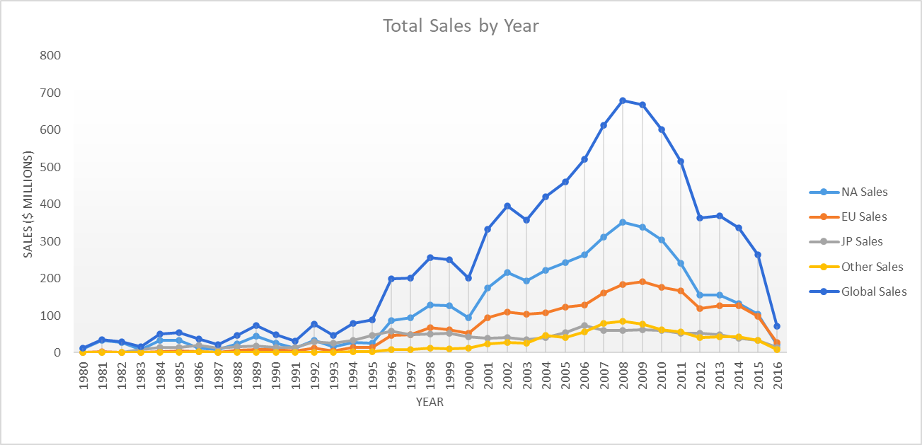
Total Sales by Year and Region: 1980-2016

Slide 4
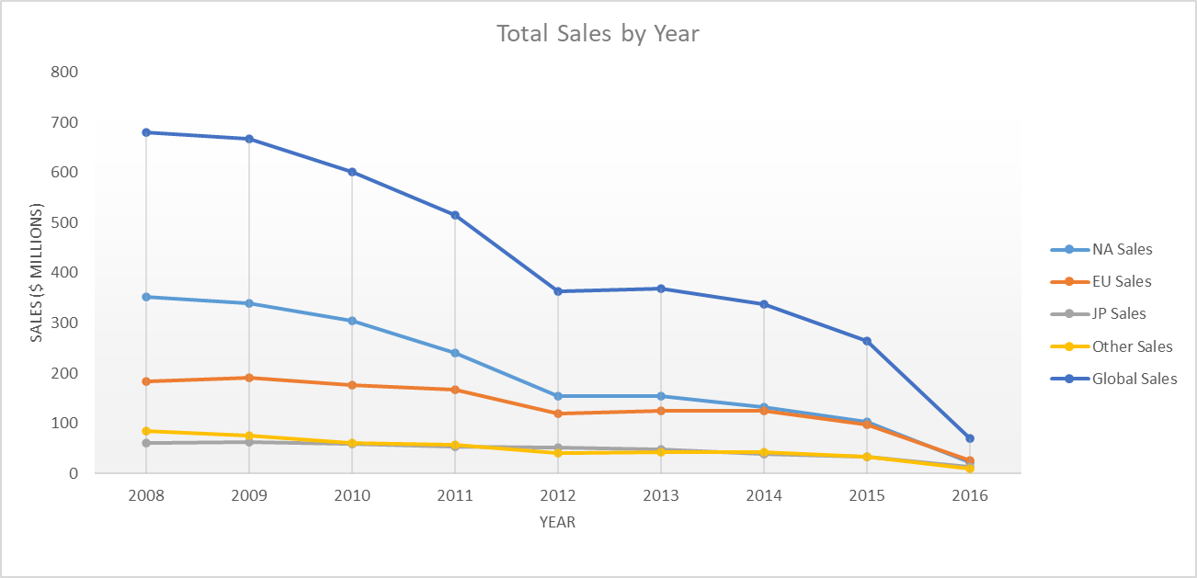
Total Sales by Year and Region: 2008- 2016
Sales have been steadily declining across all regions since 2008
2015-2016 saw a large drop in Global Sales- almost $300 million.

Slide 5
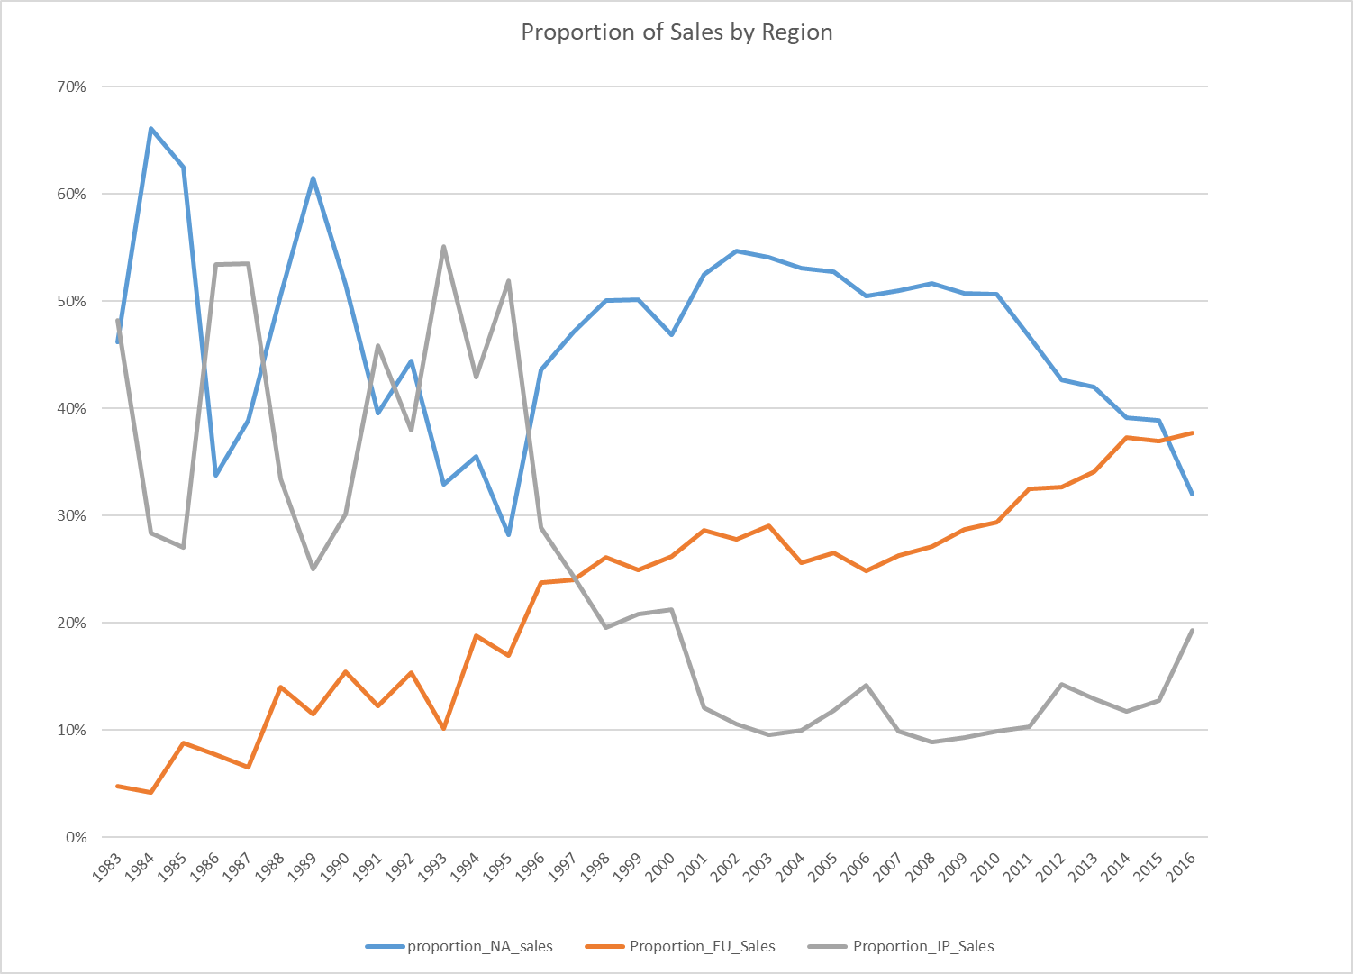
Proportion of Global Sales by Region
Historically, North America has been the largest market
That changed in 2015- North American proportion of sales is dropping
European market share has been steadily rising
Japan has been the smallest market for several years, but is growing

Slide 6
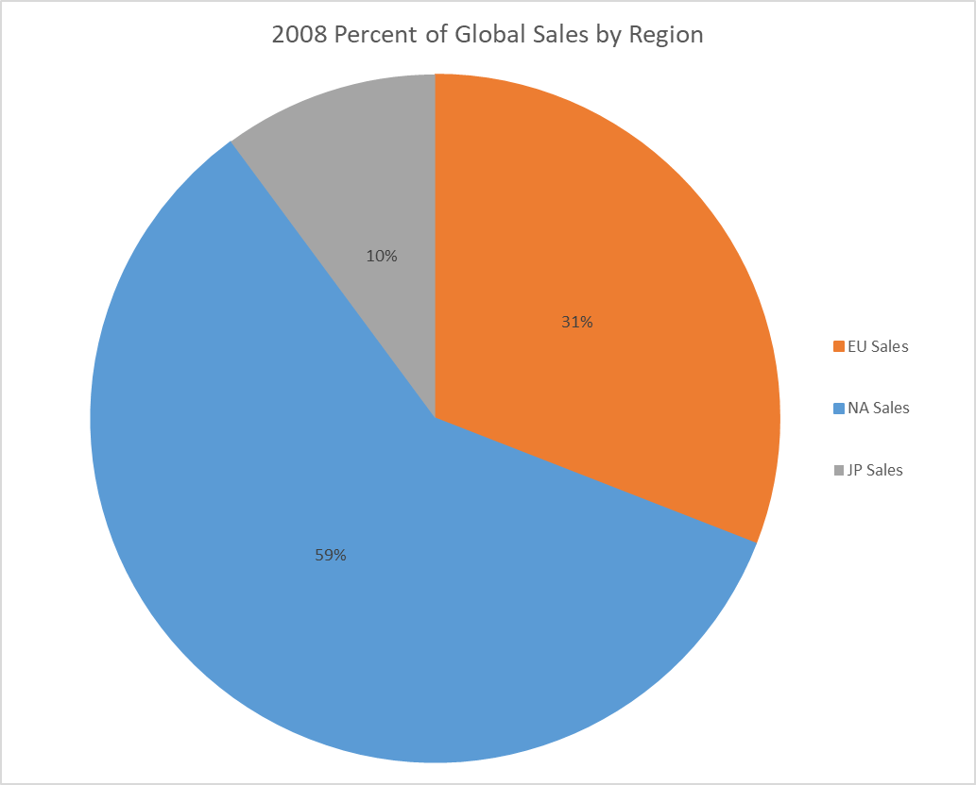
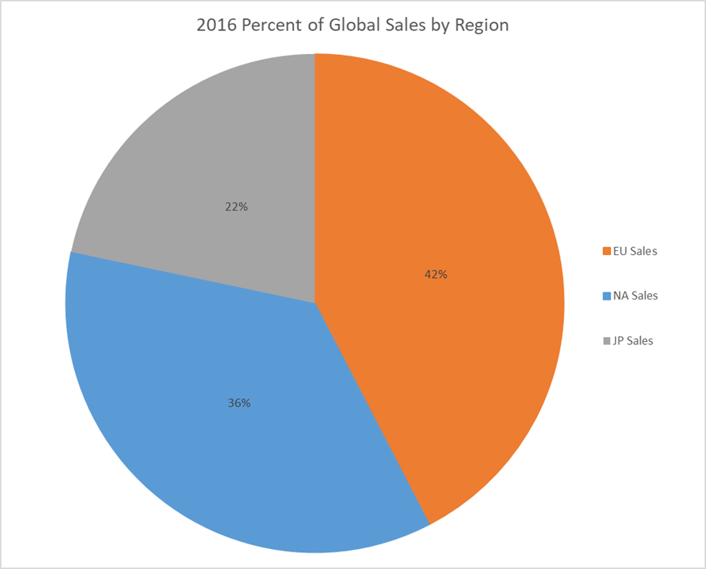
Percent of Global Sales by Region: 2008 & 2016

Slide 7
Findings from the Data
The various geographic regions have not stayed the same over time, but instead have seen large shifts.
Sales have been falling across the board since 2008.
North America is historically the largest market, but that is changing.
European sales now make up the largest share of the market.

Slide 8
Moving Forward
As stated, our original assumption that the various geographic regions have stayed the same over time is incorrect. Total sales both globally and across all regions have been declining over the past 8 years. However, proportion of European sales has been steadily rising during this time. That demonstrates a growing European market that should continue to grow, and therefore GameCo marketing efforts should be focused there.
Digital sales are not currently reflected in this data. This could be contributing to declining sales- more consumers are purchasing video games digitally rather than buying the hard copy.

